Slide 1

Basic Concepts in Mouse Studies
Hui-Ching Cheng, PhD
Department of Dermatology,
National Cheng Kung University, Tainan, Taiwan
2025.02.12

Slide 2
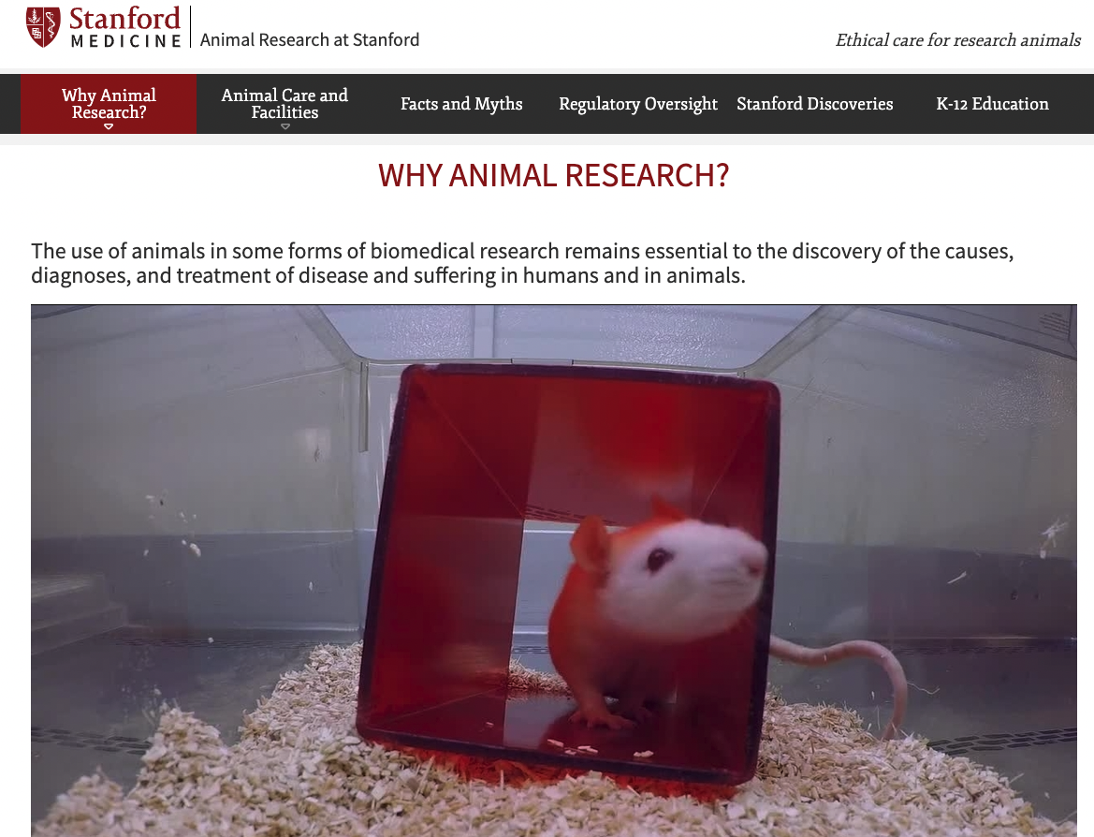
WHY ANIMAL RESEARCH?
Why Animals Are Used:
Biological Similarity: Mice share over 98% DNA with humans.
Shared Health Issues: Animals suffer from similar diseases like cancer, diabetes, and heart disease.
Life Cycle: Shorter life cycles allow for multi-generational studies.
Key Contributions:
Organ Transplantation: Immunology insights from animal studies enable safe transplants.
Cardiovascular Advances: Dogs and rats help develop treatments for hypertension and heart disease.
Polio Eradication: Vaccines developed using rhesus monkeys.
AIDS Research: Simian AIDS models aid in understanding human AIDS.
https://med.stanford.edu/animalresearch/why-animal-research.html

Slide 3
Animal Study Guidelines & Ethics
📌 Key Regulations
❌ Animals must not be taken out of the animal center.
📄 Experiments require an approved animal protocol.
🏅 Personnel must be listed in the protocol and properly trained.
⏰ Facility access: 07:00–19:30; entry outside these hours is prohibited.
🚨 Violations will be reviewed in meetings with the PI’s name disclosed.
🔬 Experiments must follow the 3R principles (Replacement, Reduction, Refinement).
💡 Mindset & Ethics
🙏 Gratitude, careful planning, and minimal use of animals.
🕯 Annual memorial ceremony to honor the contribution of lab animals to medical research.

Slide 4
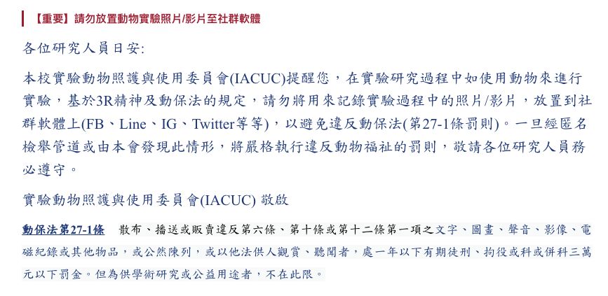
Announcements from the NCKU Animal Center

Slide 5
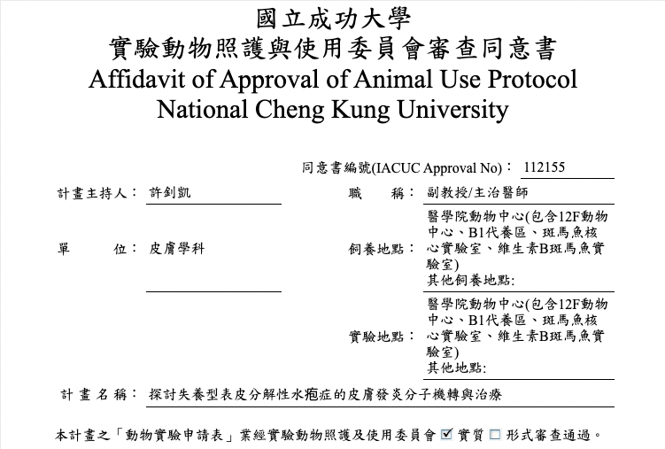
Animal Study Proposal Content
Includes:
Basic Information
Personnel Details
Animal Requirements
Research Purpose & Significance
Compliance with 3R Principles
Experimental Design Details
Drug & Injection Procedures
Pain Assessment
Euthanasia Methods
Breeding Strategy

Slide 6
Principles for Animal Study Proposal Writing
📌 Replacement
Use lower-order or invertebrate species as alternatives
Utilize in vitro models instead of live animals
Apply non-biological methods (e.g., computer simulations)
📌 Reduction
Use the minimal number of animals necessary for valid results
Refer to literature to avoid excessive animal use
Apply statistical analysis to determine the appropriate sample size
Conduct pilot studies before large-scale animal experiments
Avoid unnecessary repetition of experiments
Use non-invasive observation techniques or genetically modified animals
📌 Refinement
Minimize stress, discomfort, and pain in experimental animals
Provide suitable and feasible housing conditions
Implement professional and ethical animal care practices
Improve proficiency in animal handling techniques
Ensure precise and well-designed experiments

Slide 7
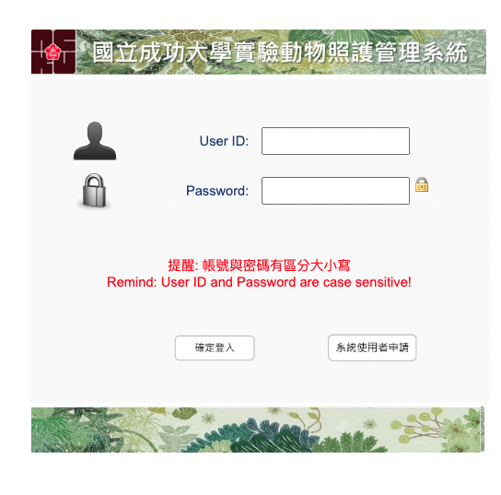
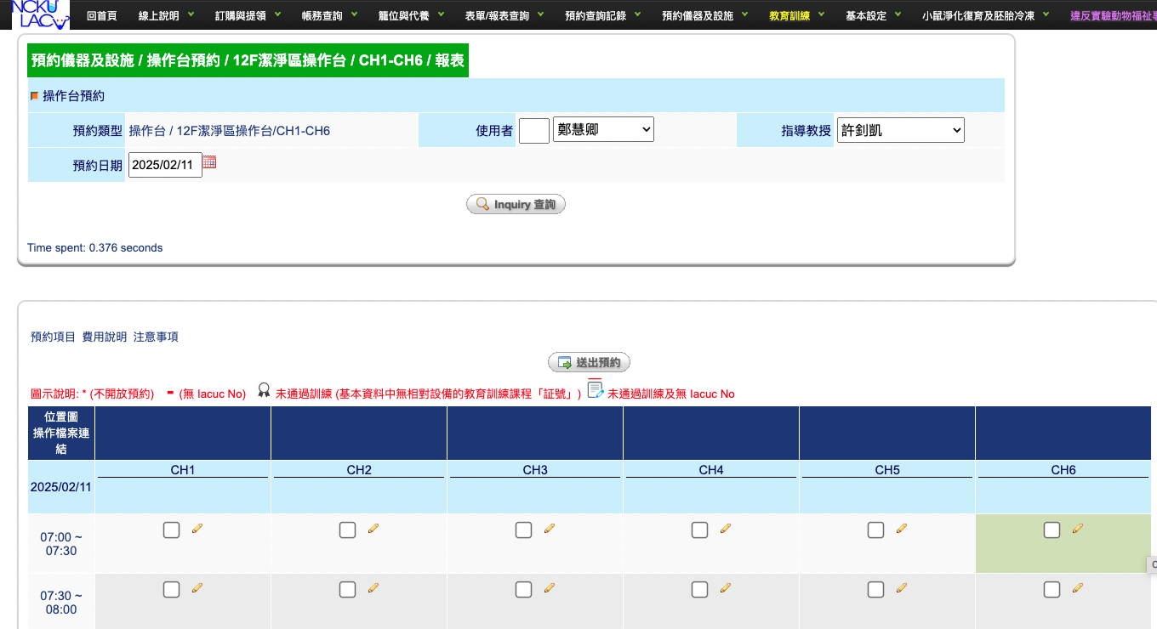
Training Courses
📌 Includes:
Restraint
Blood collection
Injection
Feeding
Genotyping
Surgical procedures
⚠️ Note: At NCKU, the entire system is in Chinese, making it unfriendly for international students!

Slide 8
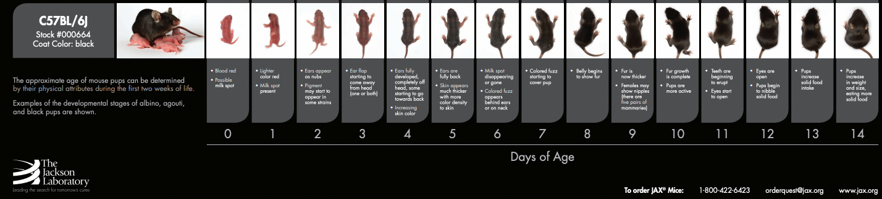
Physiological Characteristics of Mice
Condition | Period | Condition | Period
懷孕期 Gestation Period | 19–21 days | 仔鼠離乳期 Weaning Age | 20–22 days after birth
平均仔產數 Average Litter Size | 6–10 pups | 公鼠配種期 Male Breeding Age | 10–12 months
剪腳趾編號 Optimal Age for Toe Clipping | 5-10 days after birth | 母鼠配種期 Female Breeding Age | 8–9 months
開眼期 Eye Opening | 11–12 days after birth | Life span | 1.5–3 years

Slide 9
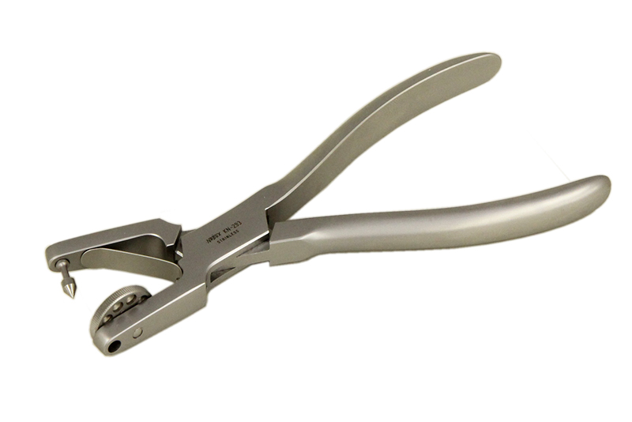
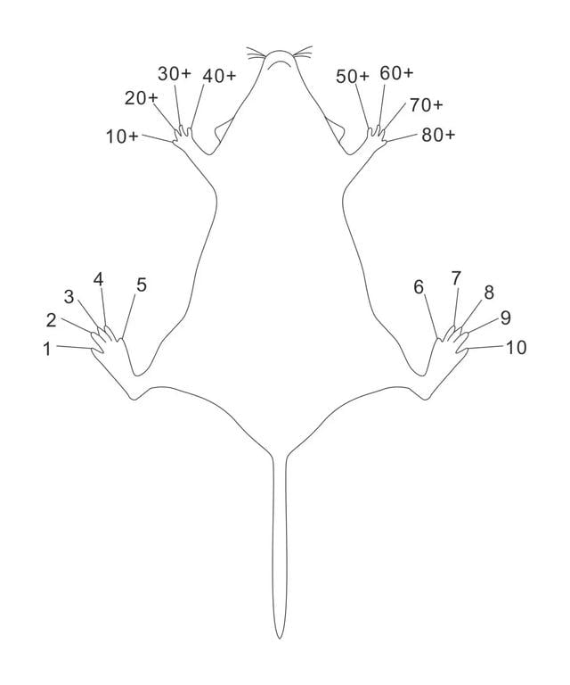
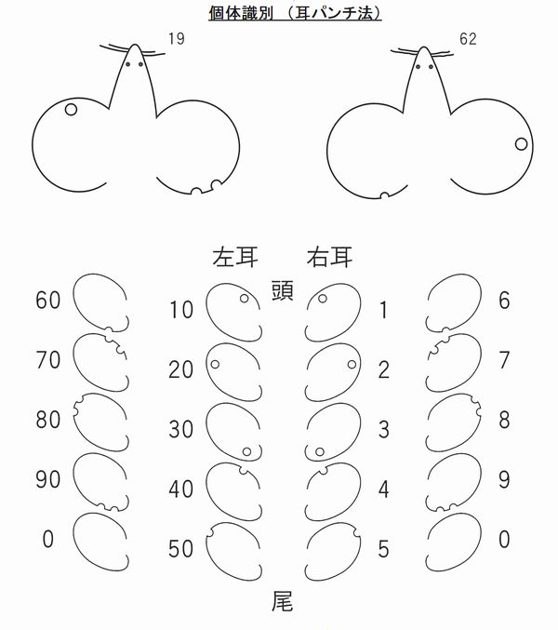
Methods for Mouse Identification
Ventral
Toe Clipping
Ear tagging

Slide 10
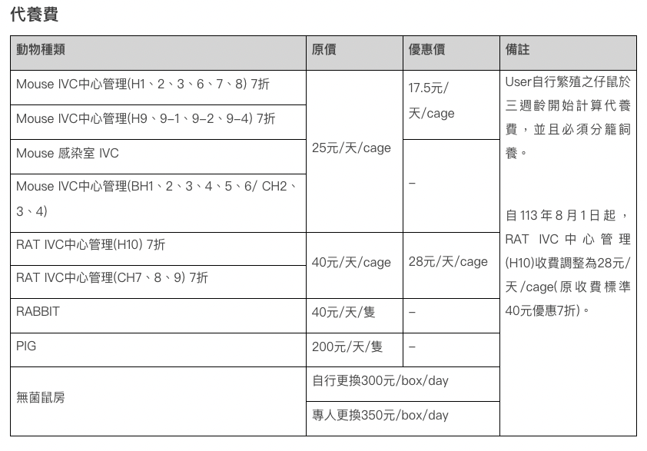
Mouse Maintenance Fees at NCKU Animal Center

Slide 11



Animal Purchase References
National Laboratory Animal Center (NLAC)
Jackson Laboratory
Lescotech Biotechnology Co., Ltd.
International Mouse Strain Resource (IMSR)

Slide 12
Take home message
❌ Animals must not be taken out of the animal center.
📄 Experiments require an approved animal protocol.
🏅 Personnel must be listed in the protocol.
⏰ Facility access: 07:00–19:30; entry outside these hours is prohibited.
🙏 Gratitude, careful planning, and minimal use of animals.
Thanks for your attention！

